Slide 1

COS 495 – Final Project
By: Robert Dorsey

Slide 2
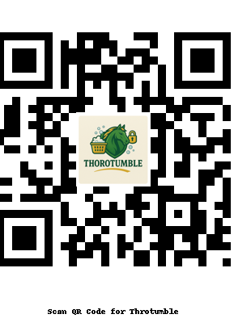
My Role in the Project
QR code to access application
Developed UI interactions
Updated Trello cards & documentation
Helped design the user manual
Worked with Zhakeya on the logo

Slide 3
What I Learned
Real-world teamwork & Scrum communication
Documenting a full software project
Importance of naming conventions
How UI/UX decisions affect user experience
Time management balancing Mister KSU duties + coursework
ThePhoto by PhotoAuthor is licensed under CCYYSA.

Slide 4
Problems Faced
Scheduling conflicts due to school events
Keeping track of task assignments
Updating repository in sync with team changes
Last-minute feature decisions causing rework
Procrastination and Not preparing myself

Slide 5
Results & Tools Used
Completed UI
Working QR code linking to Google Form
User Manual + UI/UX + Test Cases
GitHub repository
Tools: VS Code, GitHub, Trello, Canva

Slide 6

What I Would Do Differently
Start documentation earlier
Communicate more frequently
Create UI prototypes before coding
Create a calendar to balance class work and other responsibilities I have on campus

Slide 7

Overcoming Problems
Learned and Used Trello to track tasks
Finally figured out how to add the logo to the QR code
Managed time around Mister KSU appearances at the end
Eventually Stayed consistent even during busy weeks

Slide 8

Thank You

